Slide 1
Autism
Lived Experience Training for Day Cares
In 2020, the CDC reported that approximately 1 in 54 children in the U.S. is diagnosed with an autism spectrum disorder (ASD)
1 in 34 boys identified with autism
1 in 144 girls identified with autism

Slide 2
Objectives of Training
To gain knowledge from lived experience connected with children who have Autism Spectrum Disorder.
To help prepare for some challenging communication .
To give you an understanding of resources in North Dakota.

Slide 3
Overview of Autism
Individuals with Autism Spectrum Disorder (ASD) have difficulty in social interaction, language and communication, and often show repetitive interests or behaviors. Individuals with Autism Spectrum Disorders will have these core areas of difficulty in varying ranges of severity, hence this is a spectrum disorder. Every child with autism has their own, unique set of strengths and struggles. Autism may occur with other disorders as well. Some children with autism have other developmental concerns, such as below average intellectual functioning, others have normal or even high IQ.

Slide 4
Autism: Early Signs
Typical Development
Red Flags for Concern
Smiles by 2 months
- Begins to babble at 4 months
- Responds to own name by 6 months
- Copies/mimics sounds/gestures of others by 9 months
- Uses gestures and plays “peek-a-boo” by 1 year
- Simple pretend play and single words by 18 months
- Points to items by 2 years
- Shows concern for others by 3 years
- Tells simple stories by 4 years
May not know how to play or pretend with toys
- May not point at objects or look at an object when someone else points
- May not have interest in others, or may have interest but not be sure how to interact
- May not be aware of others and their feelings
- May repeat or echo words in place of typical language
- May do things over and over again and have a hard time with changes in routine
- May have different reactions to sensory experiences (ex: the way they respond to the smells, tastes, feeling, sights, or sounds of their environment)

Slide 5
What Might You See in Social Response
Limited Eye Contact
Has problems with taking turns
Has problems understanding Feelings
Limited Pretend Play
Has problems making and keeping friends

Slide 6
What Might You See in Communication
No Speech or less than normal, or prefers talking to adults
Repeats words
Echolalia
Interrupts or changes topics quickly. No conversation skills.
Perseverates or talks about 1 thing over and over again
Speech sound is unusual
“Monkey Talk”

Slide 7
What Might You See in Repetitive Interests
Only strong interest in 1 toy or object
Plays with only part of a toy such as commonly spinning wheels
Repeats movements such as flapping, spinning, head banging
Difficulty in transitioning
Prefers to be alone or outside of the circle

Slide 8
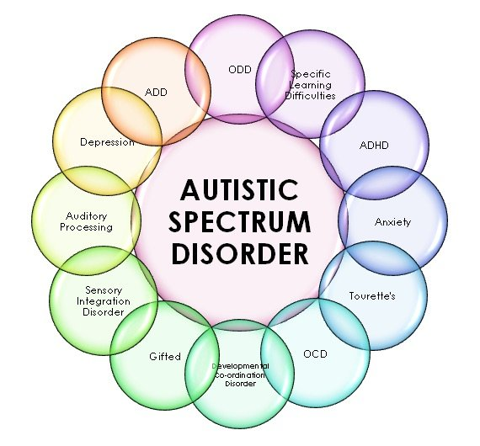
Co-existing Medical Issues for Children with Autism
78% of all children with autism experience co-existing medical conditions
Simonoff et al, 2019
40% non-verbal
31% have ID
Nearly 50% wander
48% sleeping issues
41% eating issues
51% diagnosed ADHD
7% Depression Issues
NICH 2019

Slide 9
Meaning of Behavior
Symptom of Autism or
Being Naughty???????

Slide 10
All Behavior is a Form of Communication
A child’s problematic or inappropriate behavior is a sign that he is upset and that something is not right.
Notes:
Baby may cry for hunger or wet, adult may yawn for being tired or bored

Slide 11
Children engage in challenging behavior for a reason.
Symptom of Autism
Symptom of Inappropriate Behavior
Children may screech or yell when frustrated and angry
Children may kick or bite others when they do not get their way.
Children may refuse to do work
Children may not care if they hurt someone’s feelings.
Children may poke fun at someone who is different
Children with autism may screech or yell when overwhelmed or frustrated.
Children with autism may hit others, or even injure themselves when upset.
Children with autism may pace when they are expected to sit still.
Children with autism may be self-absorbed and inattentive to events or emotions around them.
Children with autism may over or under-react to others' requests or needs

Slide 12
Modify Expectations and Change Situations
Hurting people is not ok.
Respond Quickly and Clearly
Provide Meaningful and Consistent Consequences
Offer Support for Improvement
Learn about limits directly through visuals and other means
Respond why it is wrong and how you feel about it. Sarcasm does not work as most children with autism cannot generalize.
Consistency is key Same Behavior Same Consequence
Children with autism often need immediate reinforcement for a job well done

Slide 13
Positive Attention: How To Make It Work
Make eye contact and speak enthusiastically.
Be specific about the behavior you liked and want to see more of.
Give attention IMMEDIATELY after the behavior you liked.
Give the type of attention the child enjoys.
Make attempts to purposely observe the child exhibiting good behavior.
Give positive attention for even small improvements.
Examples
If crying is a problem, praise the child for remaining calm/quiet.
If hitting is a problem, praise appropriate engagement in play activities (or activities where he/she is appropriately using hands).
If the child does not like physical contact, do not give hugs or pats on back.

Slide 14
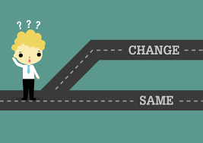
Attempts to Change Behavior
Frequent reinforcement is necessary to build understanding and trust. This process could help the child understand positive praise and help change the unwanted behaviors. Most if not all children want attention, for children with autism it may be hard to distinguish between positive and negative attention, the children need more teaching which may come natural for other peers without autism.
Notes:
For example, the child will be given a pat on the back and told, “Nice sitting,” or another praise statement every three seconds during circle time. The child may learn to expect that the teacher will praise him/her every three seconds. So, once the child is beginning to sit in circle time, the teacher can fade the pats on the back and praise statements to every 5 seconds…then, every 10 seconds and so on. Once the child has demonstrated more success with sitting in circle time, intermittent reinforcement can be used. This means the child does not know when the reward is coming. The teacher may pat on the back and praise after 10 seconds, then not again until 25 seconds, then not again for one minute.

Slide 15
Strategies
Prompting and Fading
Chaining and Chunking
Visual Schedules
Social Stories
Video Modeling
First-Then
Imitation

Slide 16
Prompting and Fading
What is prompting?
Anything that helps the child respond to a request, command or demand.
Keys to prompting.
Physical prompts easier to fade than verbal prompts
Always use least to most prompting
Fading Plan
Always have a fading plan ready
Only use as much prompting as necessary
Over prompting, child will rely on prompts too much
Notes:
What does least to most prompting mean? Gesture, indirect verbal, direct verbal, model, light physical, full physical

Slide 17
Chaining and Chunking
Teach one step at a time and break down into small manageable steps
Reduces frustration; increases success!
Critical Piece
All staff must use SAME steps!
Each step should be mastered(to the goal) before moving on to next step
Forward Chaining
First Step; master
Second Step: master
Child completes first and second step
Third Step; master
Child completes first, second and third step
Backward Chaining
Last Step; master
Next Step: master
Child completes last and next step
https://youtu.be/wMVZQICUhAk,
Notes:
Water on, hands wet, rub with soap, wash hands(20 seconds) rinse hands, dry, show clean hands

Slide 18
Visual Schedules
Pictures of steps displayed sequentially
Helpful
Transitions
Daily Living Skills
On Task Behavior
Develop
Identify routine or task
Create the pictures (use same) (can use self)
Print on template
Daily Schedules of what the child’s day will look like is predictable . A notes for when creating a visual schedule; always have a picture or symbol for a “change” so the child becomes familiar that changes do happen.

Slide 19
Social Stories
Individual stories that help children understand social concepts
Can be visual or written
Provide Support
In new situations
In confusing situations
Increasing cognitive social behavior
1) Either read the story to the child or have the child read the story to you.
2) Make a time schedule to repeat reading the story.
3) When the child has learned the narrative, keep it in a place where the child can still see it.
Notes:
Playing

Slide 20
Video Modeling
An observational learning technique in which children learn by watching a video then imitate the targeted behavior or task.
Improve
Social Skills
Empathy
Sharing
Repetition and Practice
Skill Generalization
How to use Video Modeling and Video Self-Modeling
Identify Learning Objective
Plan video and make script
Record and Edit
Choose Environment where child will watch video
Watch regularly
Practice Skill live
Self-Modeling: child plays the role. Involvement from other children.

Slide 21
First and Then
Show two activities
First activity , least preferred
Second activity, child likes and knows
Teaches
Directions
New Skills
Not as complex as schedules
How to Use
First set up task for box 1
Put picture or drawing or word of activity in box.
Choose child’s preferred activity. MUST Want! Can be a child’s choice.
Choose less preferred activity for “then”
Use as few words as possible
Use gestures and direct
“All done”
Give immediate access to preferred activity.
First do puzzles, then play outside!
Notes:
First Then App/ Boxes Box 1 child’s skill level /Just two more puzzles then outside

Slide 22
Imitation
Remedies significant barriers
Natural way of learning
Teaches how to learn
Benefits all children
Can work on body movements, sounds and simple play tasks
Disadvantages of Imitation
Some believe:
Will dimmish inner person
Not all respond to imitation
Can take much longer than other teaching methods
Requires some pre-requisite skills
Notes:
Core deficit/poor or underdeveloped imitation skills

Slide 23
Inclusion Support Grants
Grant funding and technical assistance available to licensed early childhood service providers in North Dakota who care for children with special needs ages birth through 12 years old. This program is designed to providers create and maintain an inclusive environment that supports children with disabilities or developmental delays to learn, grow, play, and develop alongside their classmates in a natural setting.
Use for:
Supporting staff needs (Up to $15,000/biennium)
Modifying a childcare setting to accommodate children with diverse abilities and needs (building ramps, widening doors, etc.) - (Up to $5,000 of one-time funding).
Buying items such as sensory equipment or computer equipment and software for children with special needs (Up to $1,000 unless there is a specific demonstrated need for a higher award
http://www.nd.gov/dhs/services/childcare/inclusion.html
Contact an Inclusion Specialist: Ashley Stroth: ashley@ndchildcare.org | 701-330-4470 Marie Cutaiar: marie@ndchildcare.org | 701-240-2660
Notes:
Will be a higher priority this session

Slide 24
Resources for Parents in ND
Family Voices of ND : www.fvnd.org
ND Autism Database: www.healthnd.gov/asd
Autism Diagnostic Clinics:
Altru Rehabilitation Center
Grand Forks ND call Tiffani Peterson @ 701-780-2481
Anne Carlsen Center
Jamestown ND call Marissa Misek@ 701-751-2315
Traditional Developmental Disability Waiver
ND Department of Health Pediatric Development Assessment Clinics
Coordinated Treatment Center
Sanford Health Fargo, ND call 701-234-6600 or 1-800-828-2901, option #3
Autism Speaks Toolkits
www.autismspeaks.org/toolkits
ND Department of Human Services /Autism Services
www.nd.gov/dhs/autism 701-328-4630 ask for Kathy Barchenger
Autism Waiver and Autism Voucher

Slide 25
References:
Center for Disease Control (www.cdc.gov/ActEarly)
McClannahan, L. E. & Krantz, P. J. (2019). Activity Schedules for Children with Autism: Teaching Independent Behavior, Second Edition.
Child Care Aware-ND (ndchildcare.org)
.

Slide 26
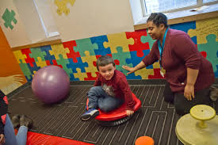
Family Voices of ND
www.fvnd.org
Call us at 888-522-9654
Vicki Peterson
701-258-2237 or 701-527-2889
vickiadc@bis.midco.net

